Slide 1






¡Basta! Prevent Sexual Harassment in Agriculture
Facilitator’s presentation

Slide 2
Welcome to the training!

Slide 3
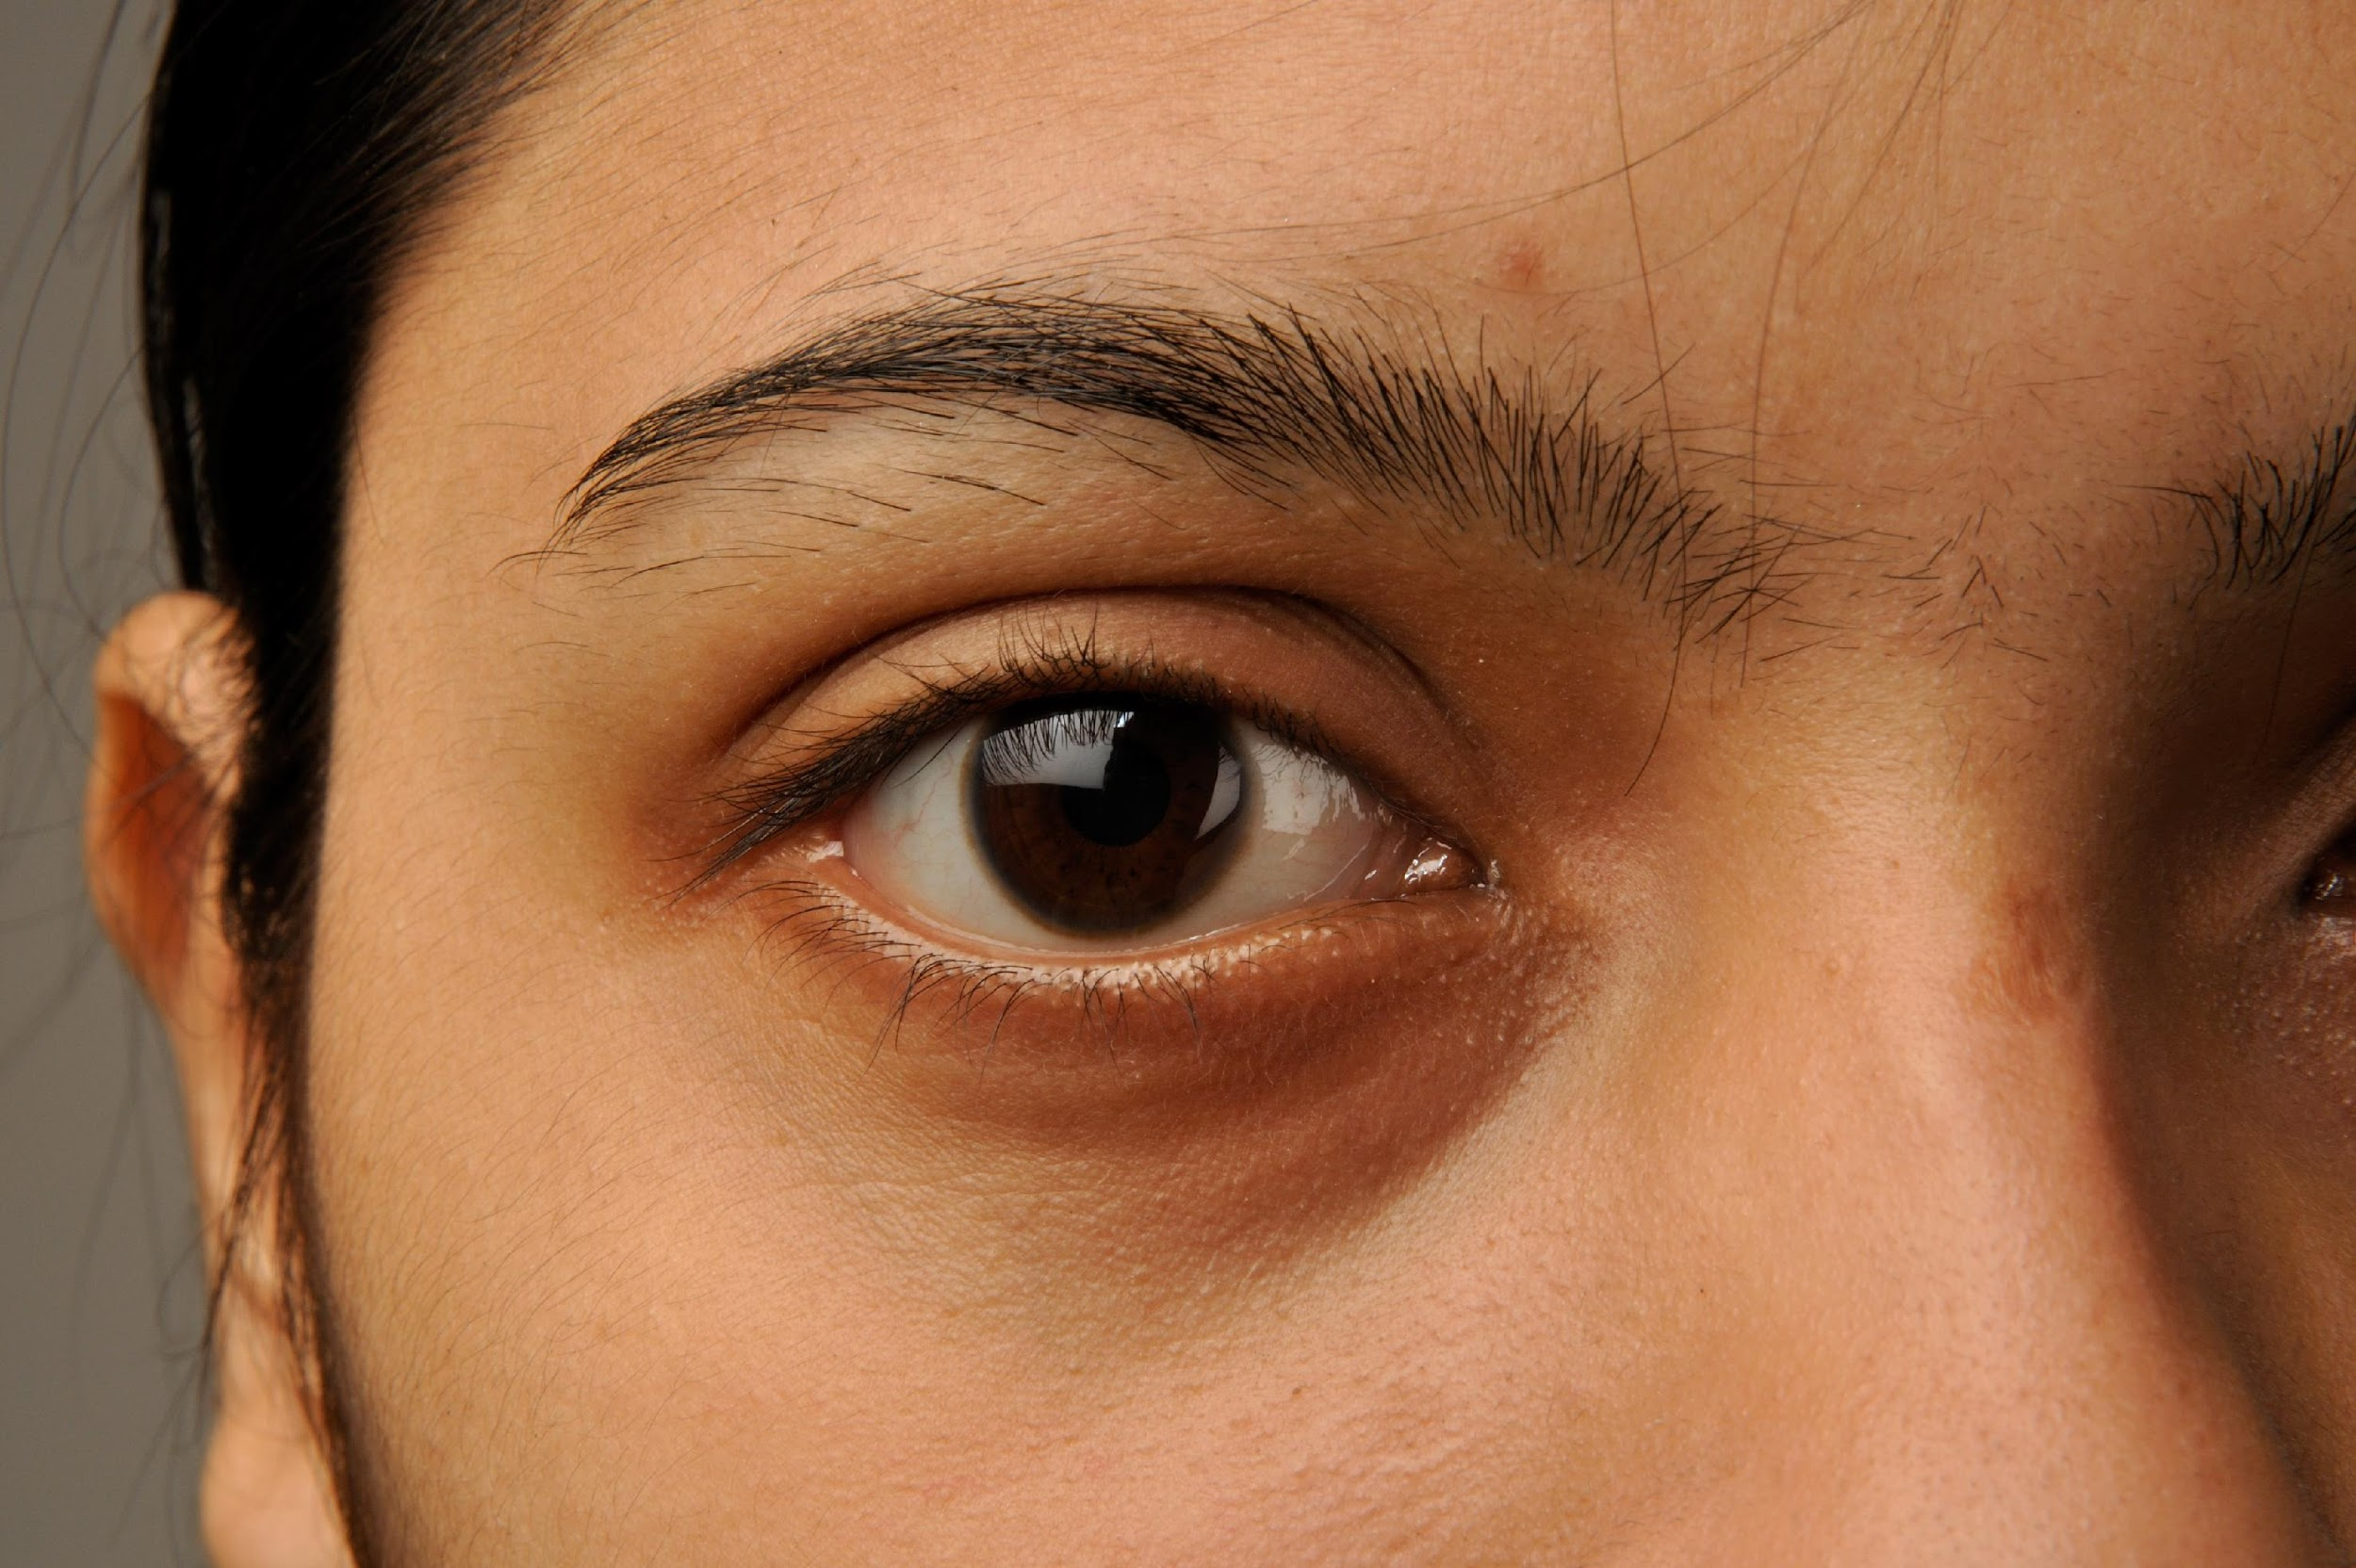
Enough is enough!
We arrive at the fields
to start our work.
We always hear someone saying,
‘What a nice ass you have!”
Get to work already.’
Enough is enough!
Some supervisors they want to
have you, offering you more hours
so that they can put their hands all over you.
They tell you, ‘How much do you charge?”
expecting you to answer,
to be able to take advantage of you.
Enough is enough!
We just want to work-- only work.
We want respect and also equality.
They were born of a woman, so
Why do they treat us badly?
Enough is enough!
We feel cornered by these coworkers,
by these supervisors,
Who abuse their power
and authority.
Enough is enough! Sometimes I want to
quit, but I have a family
that I have to feed.
You are constantly harassed.
I'm tired of crying.
Those stares make me feel so bad.
Enough is enough!
They threaten us if we report what happens
because they want to control us.
They blame us instead of themselves.
They tell us that we just come to flirt
Enough is enough!
We have to speak and denounce this -to stop this!
We deserve respect,
and we also deserve
equality.
Basta! Basta! Basta!
by Paula Zambrano (Yakima, WA)

Slide 4
Ground Rules

Slide 5
Ground Rules
Show respect to others by speaking and listening attentively.
Be an engaged and active participant.
Put your cell phones away.
Do not monopolize the conversation. Let others share their comments.
Be sensitive to others’ experiences. Don’t joke or tease.
Refrain from side conversations.
Feel free to ask questions.

Slide 6
Ground Rules
Try to keep an open mind and consider what others have to say on this topic.
If you need to leave because the conversation makes you uncomfortable, please do so and consult with your trainer and/or HR representative to connect you to supporting resources.
Maintain the confidentiality of what is shared during this training.

Slide 7
SEGMENT 1
SUPPORTING A HEALTHY WORK ENVIRONMENT

Slide 8
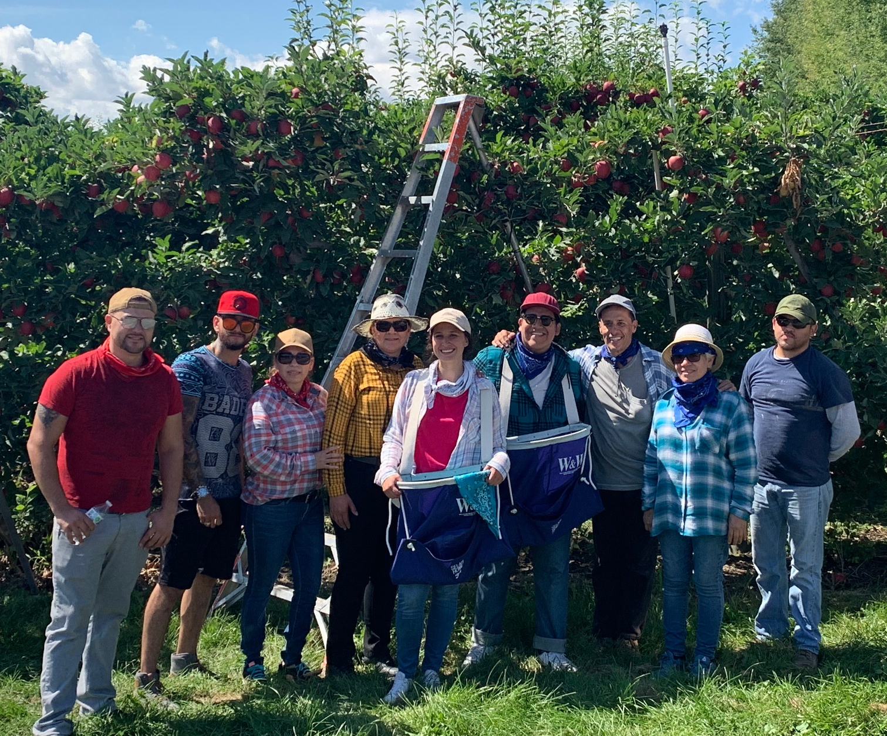
Q: What does a healthy and safe workplace look like to you?

Slide 9
Here some examples:
People work together as a team to accomplish a common goal.
People do not feel threatened.
Employees like coming to work.
It is a place where people respect one another. People call you by your preferred name.
People feel motivated to do a good job.
Employees feel a sense of trust with their employer and with each other.

Slide 10
Here some examples:
Workers can raise concerns with their supervisors about problems they encounter on the job.
Supervisors foster a safe and supportive working environment to protect and promote worker health and safety.
Diversity is valued.
Workers help and support one another.
Employers, supervisors, and workers all care about each other’s safety and well-being.
People feel respected.

Slide 11


Slide 12
Q: What does respect mean to you?

Slide 13
A feeling of regard and consideration for someone or something; to be thoughtful toward another so as not to offend or to wrong.
RESPECT

Slide 14
Q: What are common acts of disrespect in the workplace that impact the organizational climate?

Slide 15
Here some examples:
Outbursts of rage /anger/temper tantrums
indirect or direct threats
Physical violence
Discrimination/ harassment
Mis-use of power: pretense that there’s no power differential or misuse abusive use of power

Slide 16
Here some examples:
Disrespectful listening
Invasion of privacy/personal space
Fault finding /Complaining
Know it all/superior attitude
Passive aggressive – the twist added to the message to give it a bite
Misuse of power /position
Bullying behavior

Slide 17
To support a respectful work environment
What can you do as a leader to create and support a healthy and safe workplace described?
What are some of the steps you’ve taken in your business to create and support a healthy and safe workplace for all?

Slide 18
Employers can cultivate a respectful workplace…
Referring to people by their preferred name.
Providing clear and direct communication.
Demonstrating honesty and integrity.
Supporting an inclusive workplace that celebrates diversity.
Giving encouragement and praise along with constructive feedback.
Setting and promoting clear policies.
Providing safety trainings.
Ensuring those you put into positions of power demonstrate respect others.
Creating equitable pay structures.

Slide 19
Q: When is it harassment?

Slide 20
Harassment is unwelcome conduct that is based on race, color, religion, sex (including pregnancy), national origin, age, disability or genetics.
HARASSMENT

Slide 21
Types of Harassment
Remember, joking or “kidding around” becomes harassment when it’s unwelcome, pervasive and hurtful, intimidating, and takes aim at someone’s:
Genetics
Race/Ethnicity
Religion/Culture
Age
Disability
Financial status
Sexuality
Weight
Gender, etc.
Negative comments, sarcasm, and pestering can create low morale and destroy social connections.

Slide 22
What is a Hostile Work Environment?

Slide 23

Q: Would you describe this scene as a hostile work environment?

Slide 24
SEGMENT 2
UNDERSTANDING SEXUAL HARASSMENT

Slide 25
Q: Is this sexual harassment?

Slide 26

Q: How Much Do You Know about Sexual Harassment?
This Photo by Unknown Author is licensed under CC BY-NC-ND

Slide 27
Q: What is sexual harassment?

Slide 28
Pre-test content
What is sexual harassment?
Is sexual harassment a crime?
How prevalent is sexual harassment in agriculture?
Who is most likely to be a victim of sexual harassment?
What are the most common forms of sexual harassment?

Slide 29
Unwelcome sexual advances, requests for sexual favors, and other verbal or physical harassment of a sexual nature.
SEXUAL HARASSMENT

Slide 30
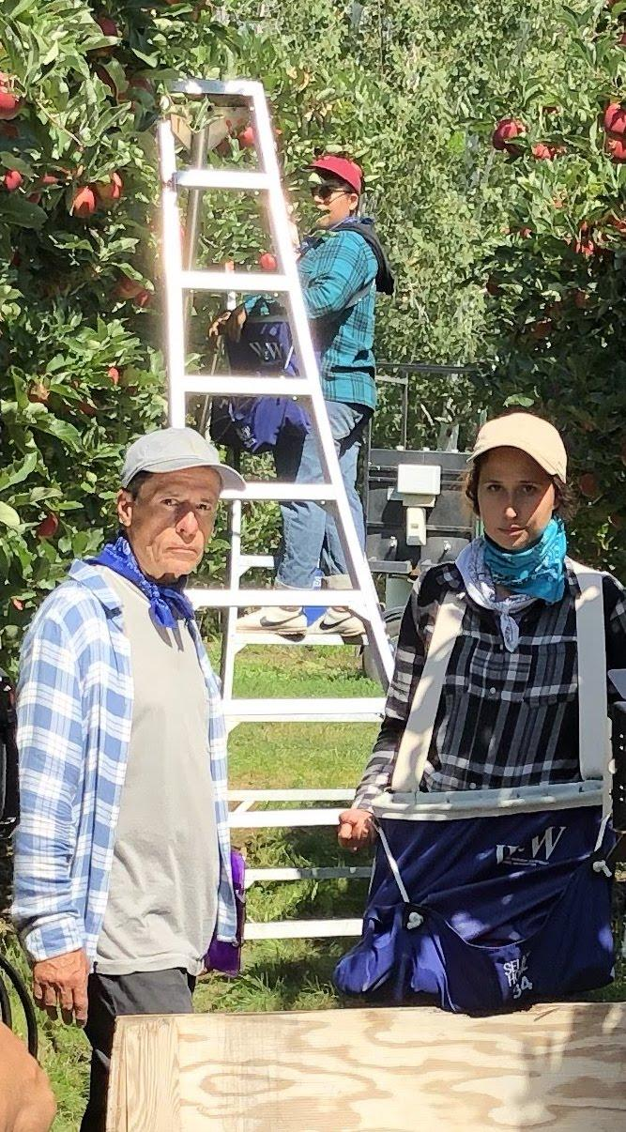
Q: Which one type of sexual harassment is demonstrated by Pedro in Scene 3?

Slide 31
Q: What factors do you think influence sexual harassment in the agricultural worksite?

Slide 32
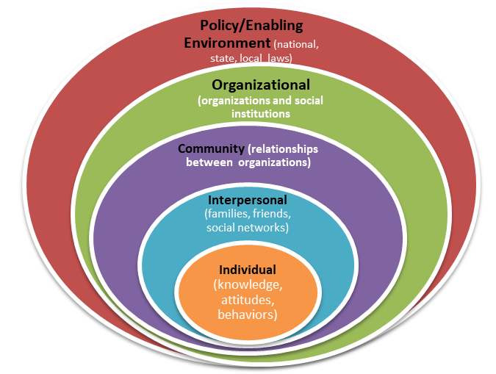
Social Ecological Model
Figure 1. Social Ecological Model. Adapted by the Centers for Disease Control and Prevention (CDC), The Social Ecological Model: A Framework for Prevention, http://www.cdc.gov/violenceprevention/overview/social-ecologicalmodel.html.

Slide 33
Q: Does your company have a sexual harassment policy?

Slide 34

Q: Does your policy follow EEOC guidelines?

Slide 35
Q: Is it posted for employees to read?

Slide 36
Q: How do Pedro’s actions threaten not only Juana’s well-being but the well-being of her colleagues and the entire company?

Slide 37







Sexual harassment Impact on the worksite and employer
Sexual harassment also impacts the entire workplace.
Employers face legal liability and financial loss
Damage to the company reputation
Negative press and media coverage
Decreased trust by employees (possible layoffs)
Loss of productivity
Loss of consumer trust

Slide 38
Disrespectful behaviors in the workplace, if left unchecked, create conditions for sexual harassment to occur

Slide 39
Q: What’s the first step someone should take if they are experiencing sexual harassment?

Slide 40
SEGMENT 3
ACTING AS A BYSANDER & ALLY

Slide 41
Q: Have you heard of the term "bystander" ? What does it mean to be a bystander?

Slide 42
A person who is present when an event takes place but isn’t directly involved. Bystanders might be present when sexual harassment occurs—or they could witness the circumstances that lead up to it.
BYSTANDER

Slide 43
Q: What were the inappropriate behaviors that can be considered sexual harassment?

Slide 44
Q:Do you think Jose should intervene in this situation as a bystander? Why/why not?

Slide 45
Q: What do you think the difference is between a bystander and an ally?

Slide 46
A person or organization that takes action to help and support another.
ALLY

Slide 47
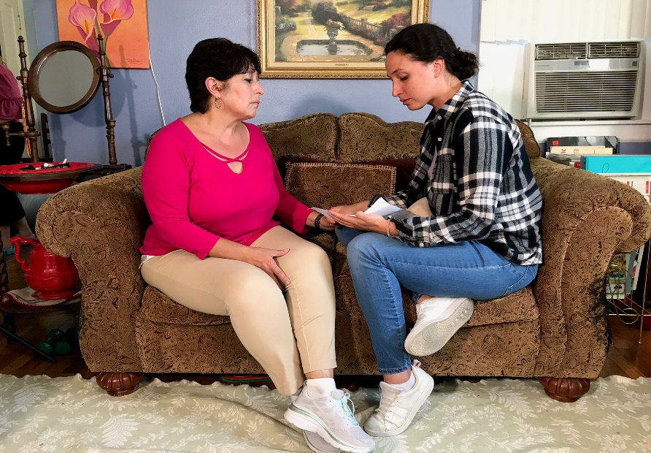
An ally is someone who does more than just observe. They provide help and support!

Slide 48
Q: What steps can you take as an employer or supervisor to act as an ally, and to ensure that employees, such as Juana and Jose feel safe to report acts of sexual harassment?

Slide 49
Some possible strategies include:
Take all claims seriously
Consider implementing a 3rd party reporting system, such as a hotline or reporting mechanism that can be anonymous.
Investigate all claims filed.
Protect the identity of the people involved.
Remember that retaliation by another worker or the employer is against the law.

Slide 50
Some possible strategies include:
Provide a clear sexual harassment policy posted in English, Spanish, and/or primary language of the employees.
Require sexual harassment prevention training.
Hire or appoint someone who is not a supervisor to act as a HR representative or to be the point of contact for employees to file a sexual harassment incident report.
Provide a confidential space for employees to talk with your appointed HR contact.

Slide 51
Q: What things might prevent someone from intervening or taking action to help someone being sexually harassed?

Slide 52
Possible barriers could include:
The person might fear of losing his job.
Face retaliation at work (e.g. reduced hours)
Fear of deportation
Risk of getting physically hurt by the harasser
Fear of harming a company’s reputation
The harasser is threatening to hurt victim or victim’s family or friends if the victims speaks out

Slide 53
No matter what the IMMIGRATION status is, EMPLOYEES have rights!

Slide 54

Q:How is taking action when you see someone being harassed a benefit to everyone in the workplace?

Slide 55
SEGMENT 4
REPORTING SEXUAL HARASSMENT

Slide 56
Q: By show of hand, how many of you are familiar with procedures for reporting sexual harassment?

Slide 57
Q: What’s the first step Juana should take to report sexual harassment?

Slide 58

Q:Who is that appointed person at your workplace?
This Photo by Unknown Author is licensed under CC BY

Slide 59
Q: What should Juana do if saying “No” is not enough?

Slide 60
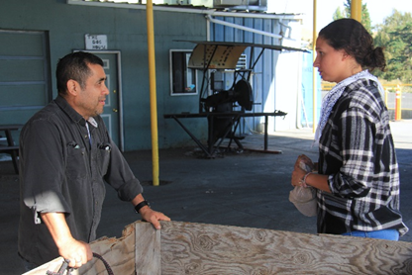
Remember, not all supervisors behave like Miguel in this scene.
This Photo by Unknown Author is licensed under CC BY-NC-ND

Slide 61
Q: What happens to the employer if they fail to take a report of sexual harassment seriously?

Slide 62
If the supervisor's harassment results in a hostile work environment, the employer can avoid liability only if it can prove that: 1) It reasonably tried to prevent and promptly correct the harassing behavior. 2) The employee unreasonably failed to take advantage of any preventive or corrective opportunities provided by the employer.

Slide 63
The employer will be liable for harassment by non-supervisory employees or non-employees over whom it has control (e.g., independent contractors or customers on the premises), if it knew, or should have known about the harassment and failed to take prompt and appropriate corrective action.

Slide 64
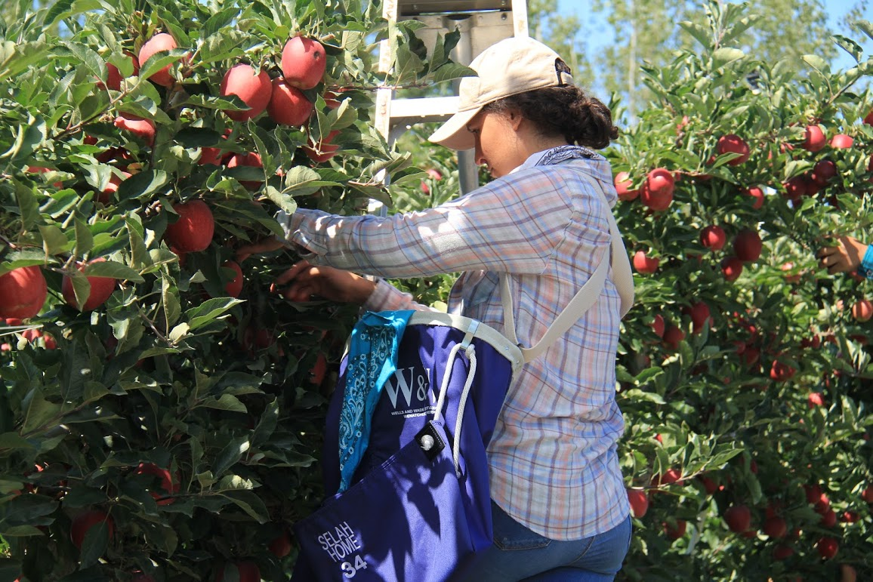
Q: So what should Juana do next?

Slide 65
Q:What steps should you take to report sexual harassment?

Slide 66

Q: What kinds of things should someone being harassed write down to report what happened?
This Photo by Unknown Author is licensed under CC BY-SA

Slide 67

Q: Why does documentation matter so much?

Slide 68
SEGMENT 5
PREVENTING SEXUAL HARASSMENT

Slide 69
Q: Who is responsible for preventing sexual harassment?

Slide 70
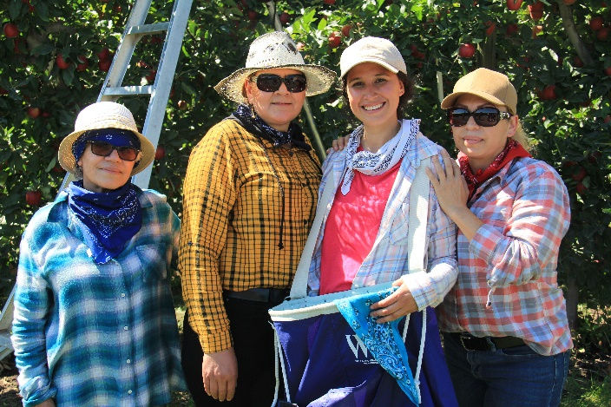
WE all can do something to STOP sexual harassment!

Slide 71
STRATEGIES FOR GROWERS

Slide 72

Refer to the handout, Tips for Growers by Growers.

Slide 73
Strategies
Growers are key to establishing a work environment that prevents sexual harassment.
The grower oversees the implementation of a sexual harassment policy and reporting process that is easy to understand by employees and followed.
Establishing protocols within the company is critical to sexual harassment prevention, such as establishing an effective complaint process, and by taking immediate and appropriate action when an employee complains.

Slide 74
Strategies
Supporting organizations such as the EEOC and your state’s Grower’s League can help provide advice and resources for establishing protocols.
Employers should ensure that each claim is investigated and that discipline for harassment is prompt, consistent, and proportionate to the severity of the circumstance.
Providing training to employees in order to minimize worksite hazards including sexual harassment is also a key responsibility of employers.

Slide 75
Strategies
Providing leadership training and support for supervisors and mid-management will help to reinforce and to support the company mission, values, leadership and expectations, and help supervisors address challenging situations, including harassment in the worksite.
It’s also important for growers to be mindful about who they are promoting as supervisors in the workplace since most sexual harassment claims are against supervisors.
Other ways to reduce sexual harassment and to improve power dynamics as well as inclusivity in the workplace are to appoint crew leaders or multiple supervisors, and to promote more women into supervisory positions.

Slide 76

Q: Do you have any ideas or suggestions that can help improve communication and respect in the workplace?

Slide 77
Providing regular anti-harassment training as well as reminders can send a clear message to your employees: sexual harassment is not allowed at your company.

Slide 78


Remember, sexual harassment is not only a crime, it also could cost you money, productivity and hurt your business.

Slide 79
Q: Does your policy follow EEOC guidelines?

Slide 80
Q: Is there anything you do at your site that we have not mentioned?

Slide 81
STRATEGIES FOR SUPERVISORS

Slide 82
Q: How can you, as a supervisor, help to reduce sexual harassment in your workplace?

Slide 83
Watch the video “Grower’s as Allies to Prevent Sexual Harassment.”

Slide 84
Strategies
Most sexual harassment is committed by supervisors toward employees.
Supervisors must not abuse their power and should model respect toward others.
As a supervisor and leader, it’s important to be objective and fair.
If you are dating or wish to pursue a romantic relationships with someone you supervise, you should report this to your employer.
Supervisors should attend company trainings and follow the protocols for reporting sexual harassment if they witness it or are experiencing it.
seem biased, the supervisor should notify their boss/grower or HR contact to appoint someone else to work with the employee to file the claim.
5.4

Slide 85
Strategies
They should also be very familiar with company policies and protocols and follow them.
Lack of communication or miscommunication can hinder a person from reporting sexual harassment.
Do your part to ensure that those you supervise understand the company policy on sexual harassment.
Supervisors should also avoid situations where they are alone with employees or in situations where they can cause reason to be accused of sexual harassment.

Slide 86
Strategies
Supervisors also have a responsibility to report employee claims of sexual harassment to HR or appointed persons and to keep information about the case confidential.
If there is a conflict of interest (e.g. supervisor is friends with the accused harasser), that would make the reporting process seem biased, the supervisor should notify their boss/grower or HR contact to appoint someone else to work with the employee to file the claim.

Slide 87

Review your company’s sexual harassment policy

Slide 88
Q: Do you have any questions or closing thoughts about what we’ve discussed today?

Slide 89
Post-Test

Slide 90
Thank you! Gracias!

